Slide 1
Portfolio Creation and Behavioral finance
Presenter: Ali Akbar Fani

Slide 2
Overview
1. What is an Investment Portfolio?
2. What you need?
3. How it works
4. Behavioral Finance
5. Methodology
6. Overall Flow

Slide 3
What is an Investment Portfolio?
In finance, Investment portfolio is a collection of all your investments.
This can include:
Stocks
Bonds
Cash
Real estate

Slide 4
What you need?
Investment sectors.
Risk to reward/returns ratio.
Urge to invest.

Slide 5
How it works?
Financial Process
Technical Process
Standard & Poor’s 500 index is a market capitalization –weighted index of 500 largest US traded companies
S&P 500
- High Tech
- Healthcare
-Pharma
Sector Identification
List of securities
Portfolio creation
Data Set
Clustering
Stock Picking

Slide 6
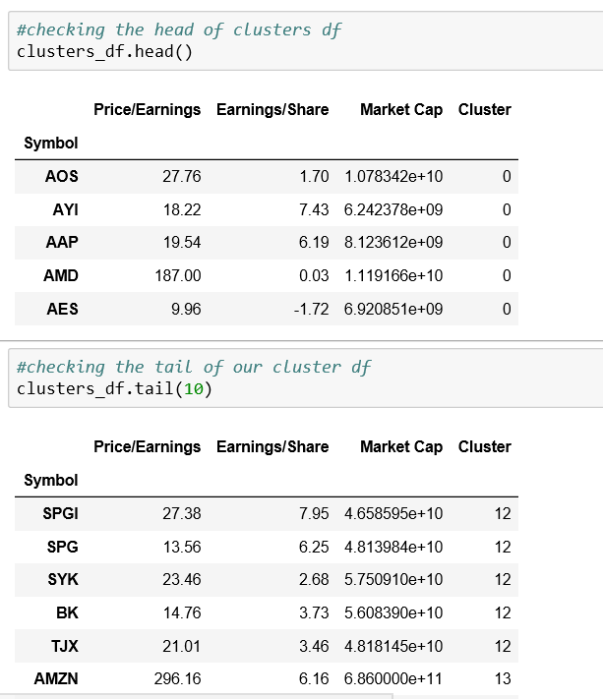
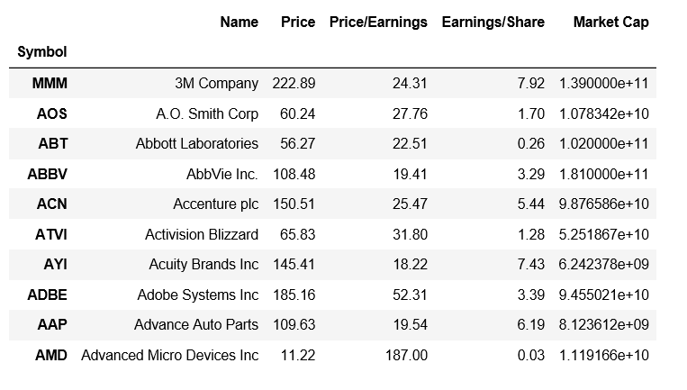
Results 1
S&P 500 Data set
Clustering

Slide 7
Behavioral Finance
It is a sub-field of behavioral economics, purposes psychology-based theories to explain stock market anomalies.
Behavioral Finance paradigm suggest that investment decision is influenced in a large proportion by psychological and emotional factors.
Twitter, reddit and other news channel.

Slide 8
Methodology
Twitter/Reddit
Data Collection
Stock Market data
Sentiment Analysis
Price Analysis
LSTM Neural Network
Stock Price prediction

Slide 9
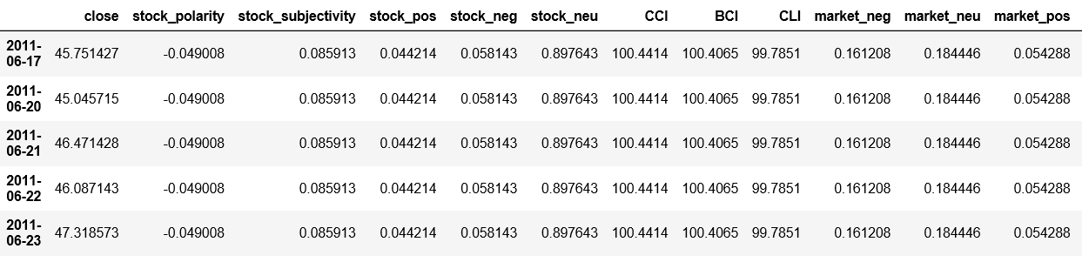
Results 2
Stock data + Market Sentiments data

Slide 10
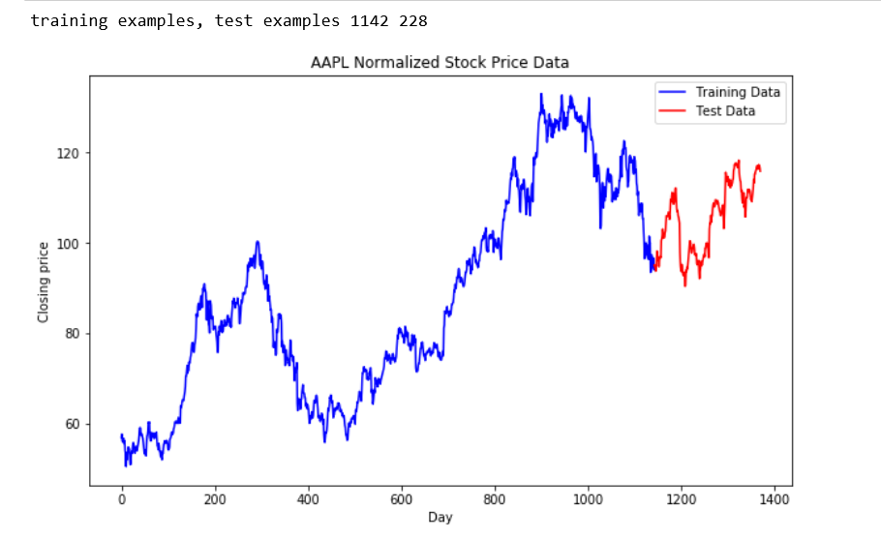
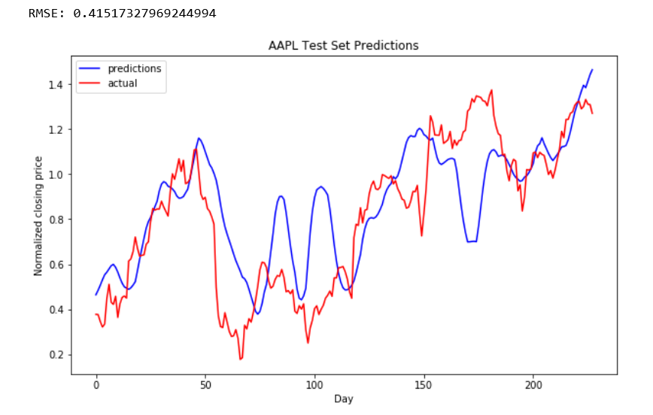
Results 2 contd.

Slide 11
Overall Flow
1
2
3
4
Client requirement
Return Policy
Risk Assessment
Portfolio Creation
6
5
Co-Integration/
Tradable relation
Stock Identification
Identification of cluster
7
Pairs
8
9
Selecting pairs for portfolio creation based on return
Behavioral
Finance
Monitoring
Stock prediction based on Sentiments
10

Slide 12
References
https://money.usnews.com/investing/articles/2016-05-06/how-to-build-a-stock-portfolio
https://smartasset.com/investing/what-is-an-investment-portfolio
https://www.quantstart.com/articles/Cointegrated-Augmented-Dickey-Fuller-Test-for-Pairs-Trading-Evaluation-in-R
https://www.investopedia.com/terms/b/behavioralfinance.asp
https://en.wikipedia.org/wiki/Market_sentiment
http://www.wiu.edu/cbt/jcbi/documents/NAASFeb2016/SpecialNAASIssueFeb2016-InvestorSentiment.pdf
https://www.investopedia.com/terms/s/sp500.asp

Slide 13
THANK YOU!

